Slide 1
OCAP Reference Implementation – CableLabs tru2way Workbench
September 11, 2008

Slide 2
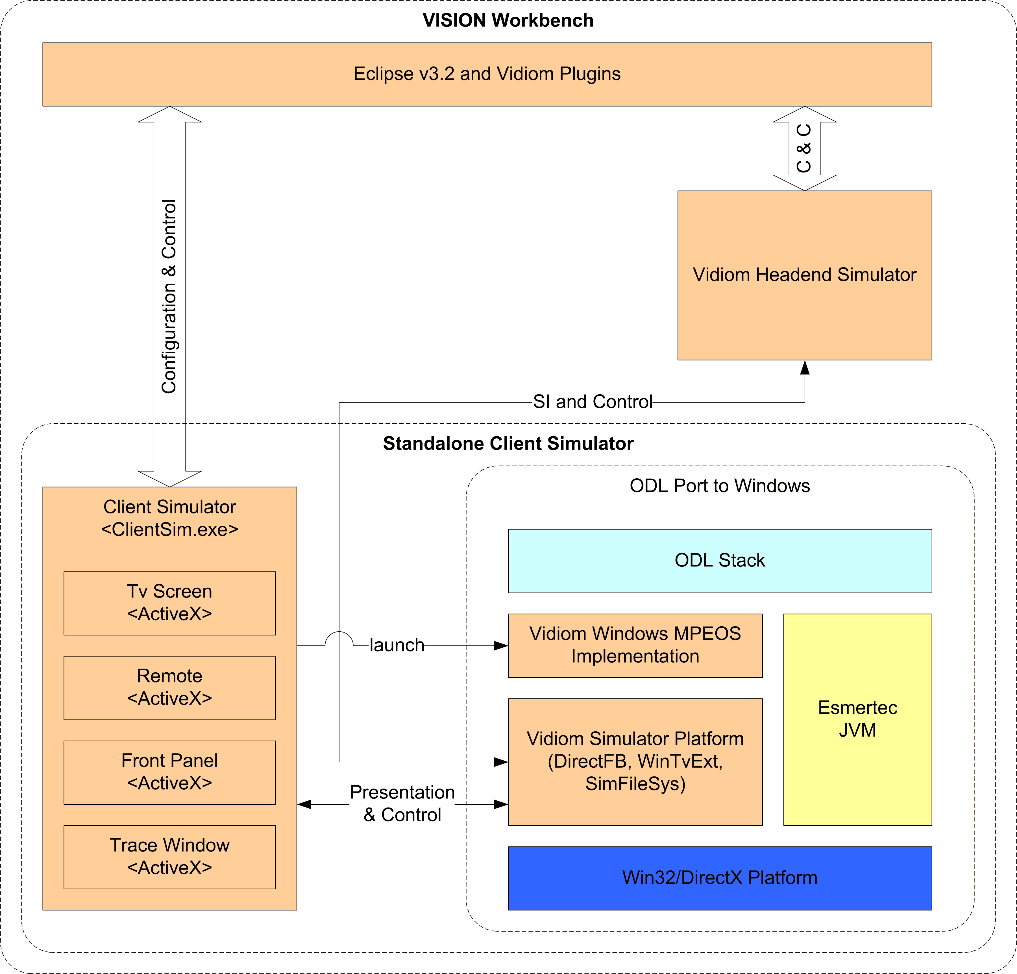
VISION Workbench Architecture

Slide 3
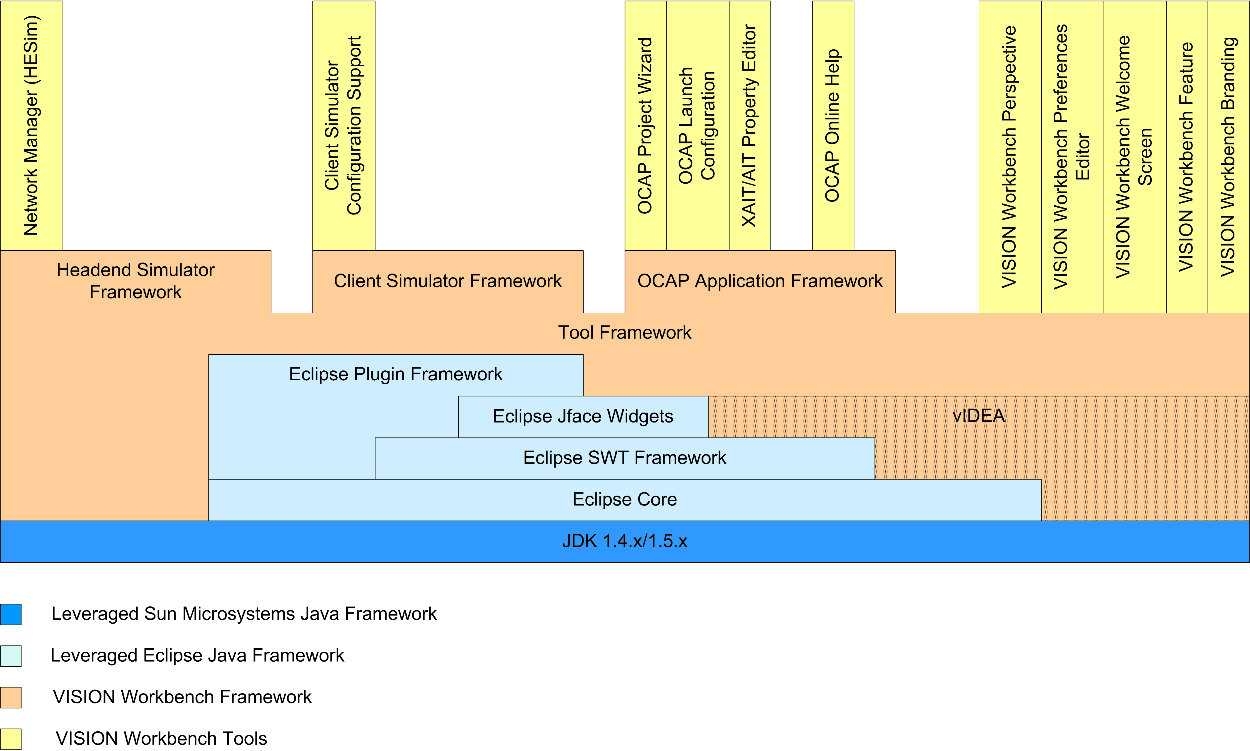
VWB Architecture cont.

Slide 4
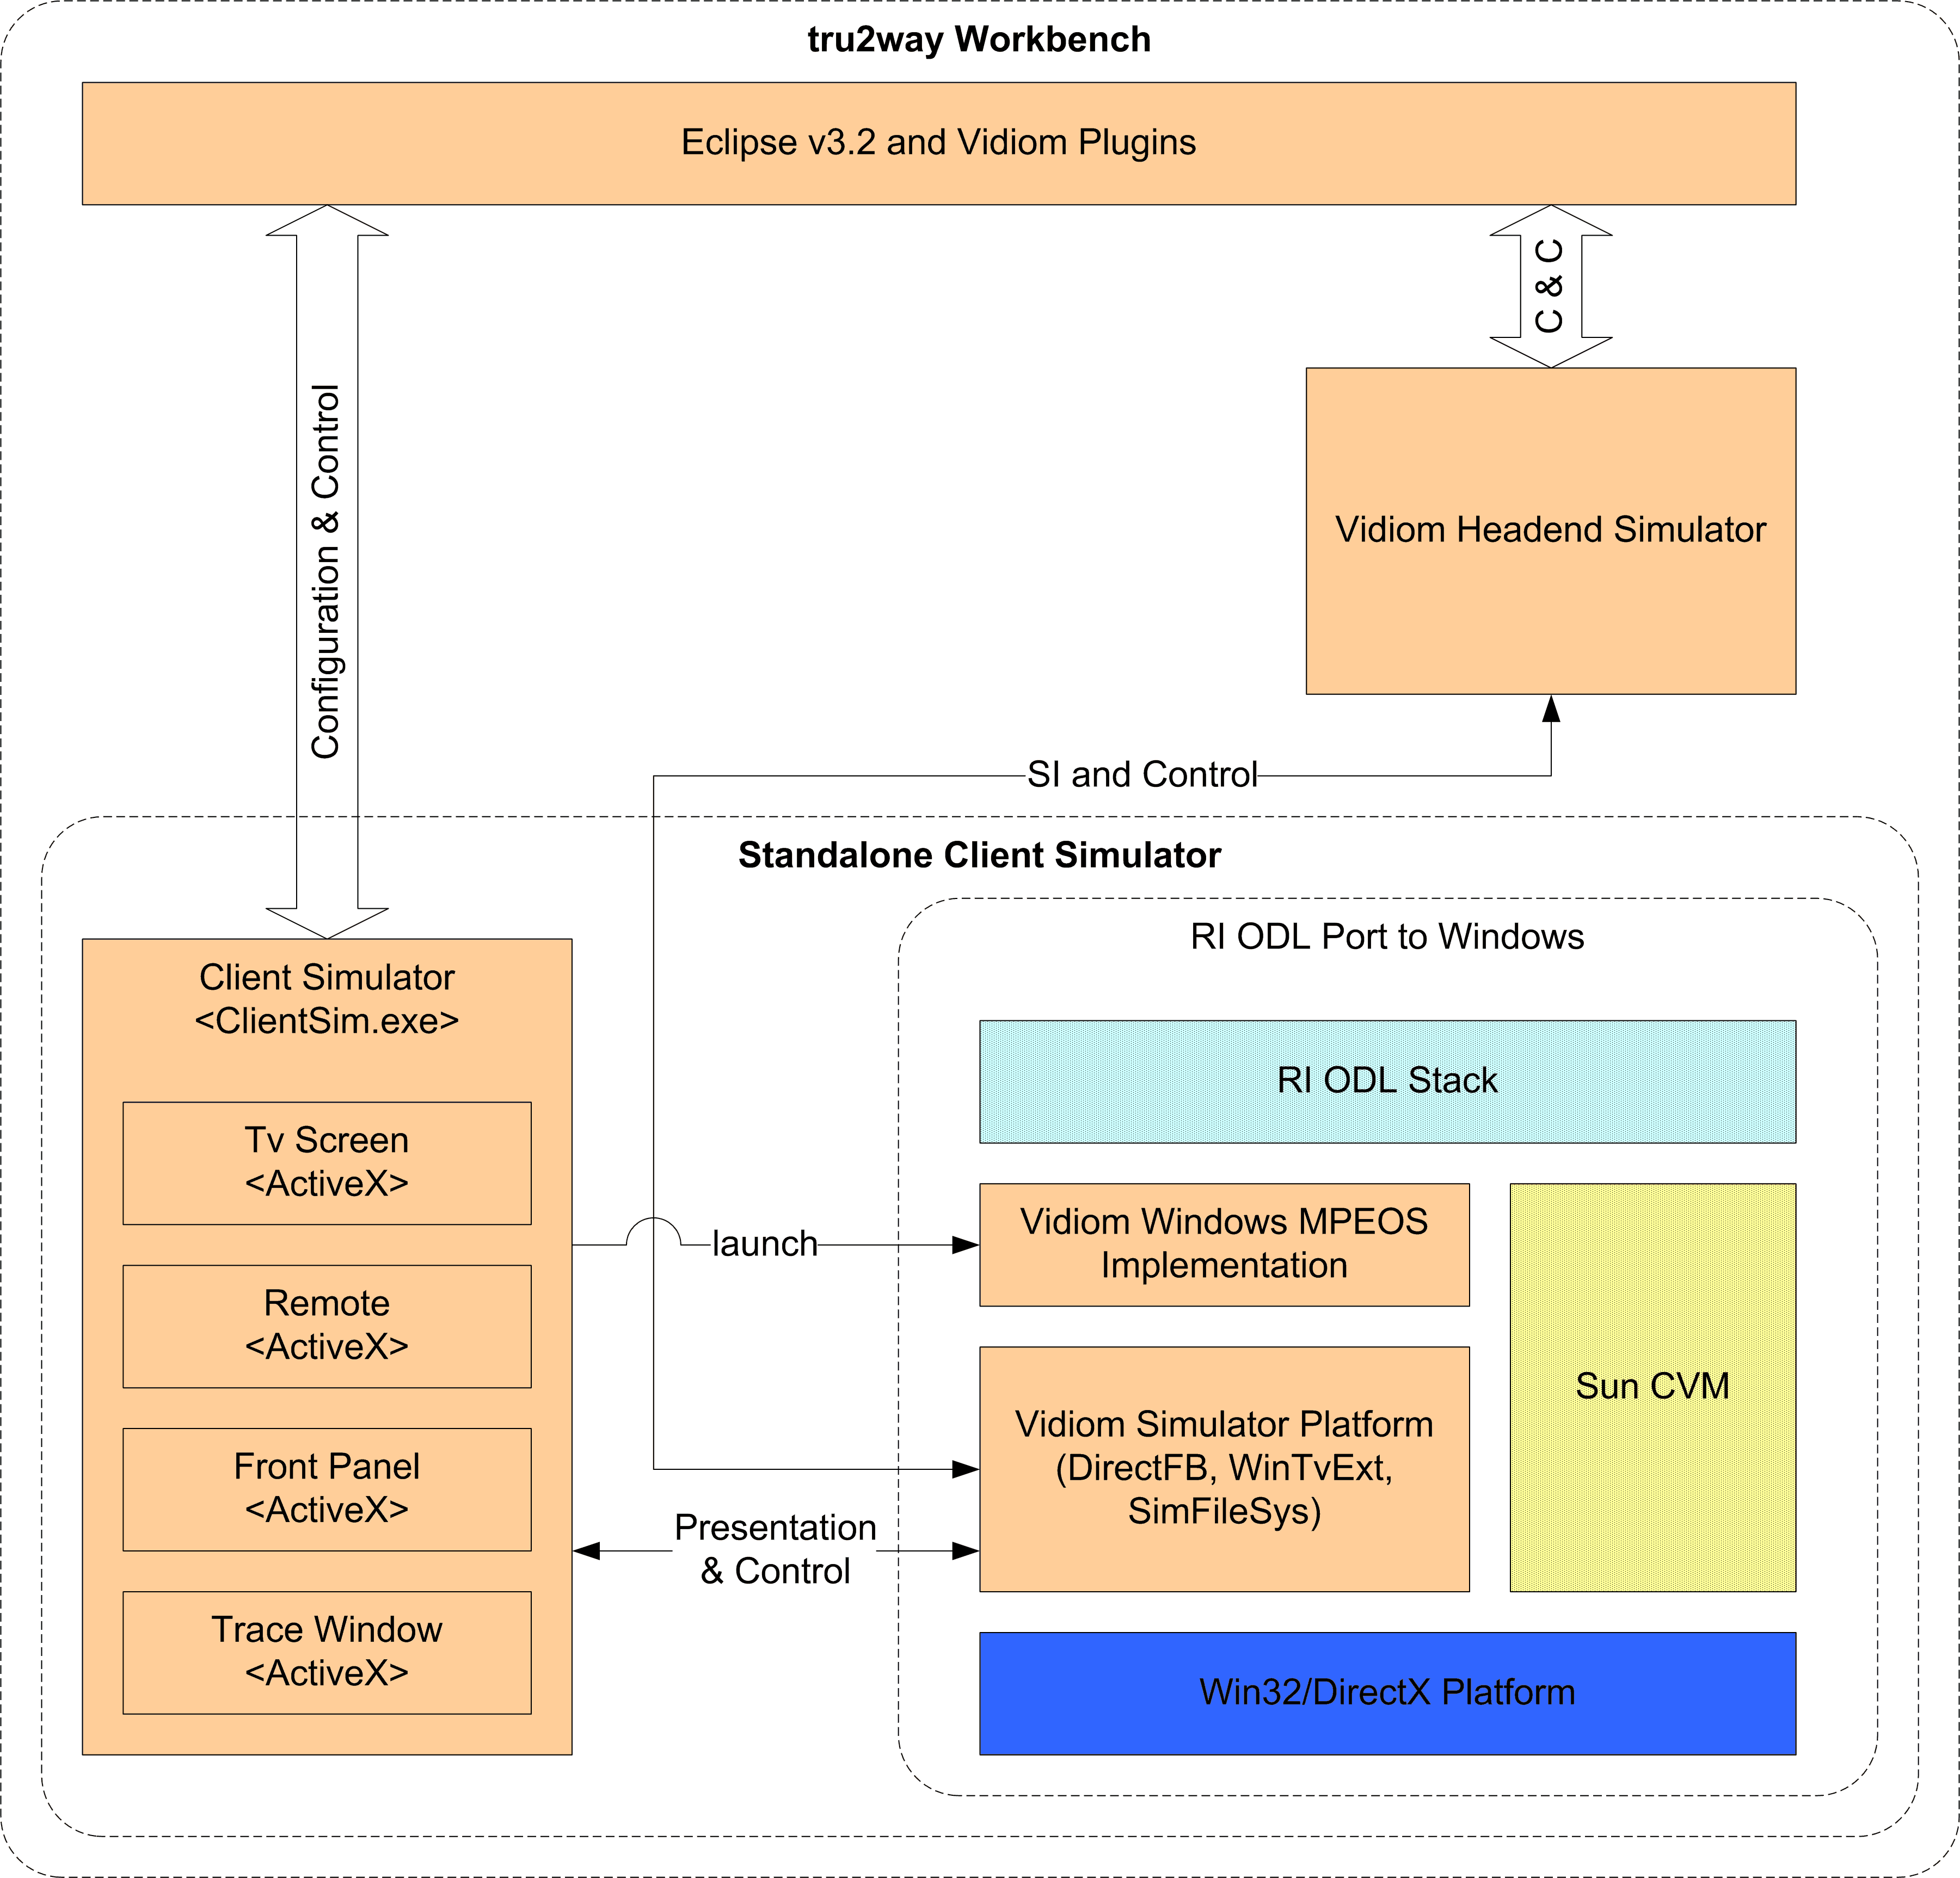
tru2way Workbench Architecture

Slide 5
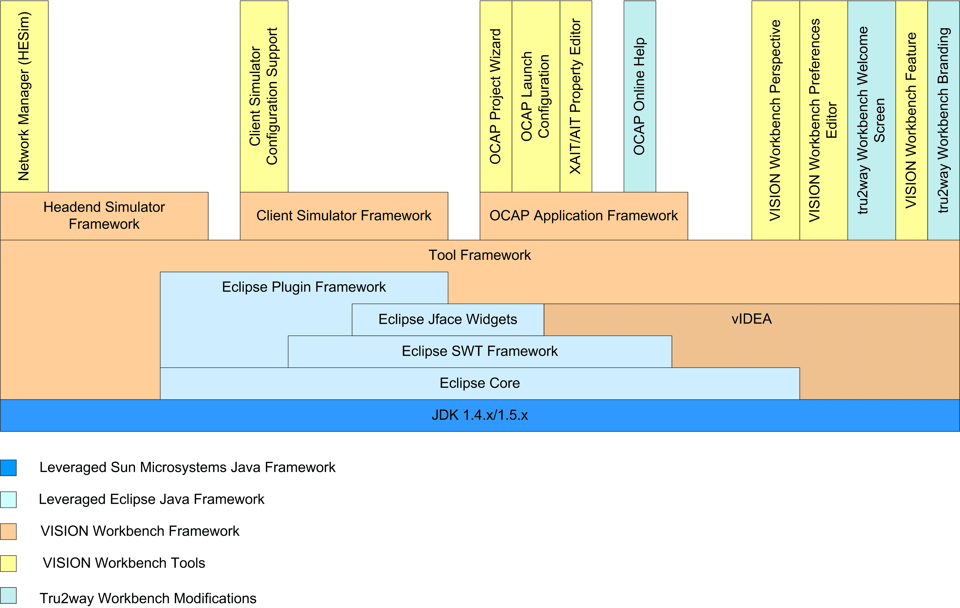
tru2way Workbench cont.

Slide 6
tru2way WB Release Tasks
Merge Vidiom’s Perforce mainline into the June branch
Update copyright in Client Simulator code with “open source” verbiage
Remove Vidiom Help plugin and documentation
Modify VWB feature plugin
Update copyright in Eclipse and Headend Simulator code with “open source” verbiage
Update Eclipse plugins about text and plugin info text
Update splash screen and icons
Update Vidiom Remote and Front Panel images
Update Welcome Eclipse plugin
Update batch build script for release distribution (need to remove Aladdin licensing step)
Update release notes
Update version fields
Build an InstallShield release
Test release distribution

Slide 7
tru2way WB Release Issues
Past VWB releases required Sun Tck validation of stack. This has not been completed with RI ODL Stack and Sun CVM.
Release process uses InstallShield 7 which is no longer available. InstallShield scripts and release build will need to be updated to current product offering.
How much time will be spent testing the release distribution? 1 week? 2 weeks? Who will do this besides me?
Are there going to be any release notes? Are these relative to VWB 1.2 ER1 Release?
Do we have to worry about distributing the source on a web site anywhere?
Do we have to support the build environment for the open source release? No top-of-tree batch build for VWB or its components accept through the InstallShield release process.
Where should Welcome Screen point people to for support?

Slide 8
tru2way WB Project Path
RI Emulator configuration and launch management
HE4RI configuration and launch management
OCAP project workflow
Network-centric workflow
ATE integration
Application packaging and deployment
TvWorks iTv Eclipse Framework

